Slide 1
The Sex Lives of Honeybees

Slide 2
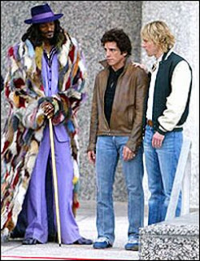
Or if you want to be a little salacious:
Beekeepers as

Slide 3
Pimps (& madams)
Bet you never thought of yourself in those terms as a beekeeper.
But a big part of beekeepers job is managing the reproductive lives of your bees.

Slide 4
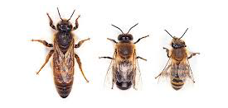
Where to begin…

Slide 5
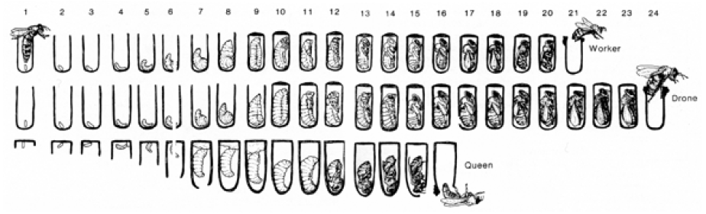
Development from egg to adult bee

Slide 6
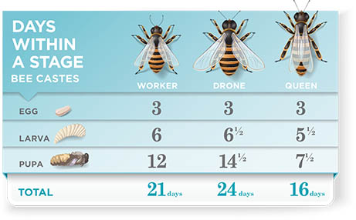

Slide 7
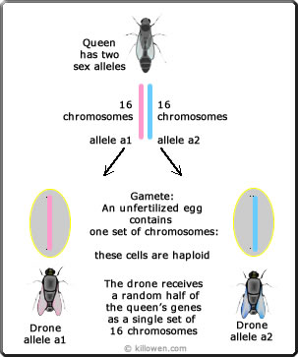
Drones are
Haploid
Females are diploid

Slide 8
Lessons from Drone
Days to emerge: 24
Days to sexual maturity: 24 + 10 = 34
Life expectancy: 60 Service life 26 days
What does that say about early queens?
Why are drones essential to nature?
What percentage of genes come from drone?
Why do hives get laying workers?

Slide 9
The Queen
Has spermatheca (bladder)
mated queen has sperm from up to @15 drones in the bladder (2-6 million sperm)
Flies 1-2 km to drone congregation area
60% of queens perform 2 (10-30 minute) mating flights

Slide 10
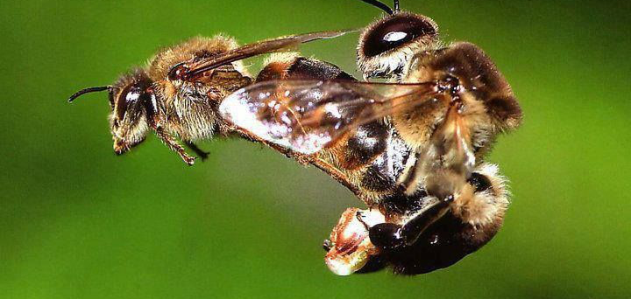

Slide 11
Queens life calendar
Days to emerge 16 (11 effective)
Days to harden up 5 at least
Days of maiden flights 6+ (weather)
Day to begin laying 2-14
Productive life? ????
until injury, lack of sperm age
or ill health does her in.

Slide 12
Worker life calendar
Think of 3 periods of 21 days each
* Days to emerge: 21
* Days as a house bee: 21
* Days as a forager: 21

Slide 13
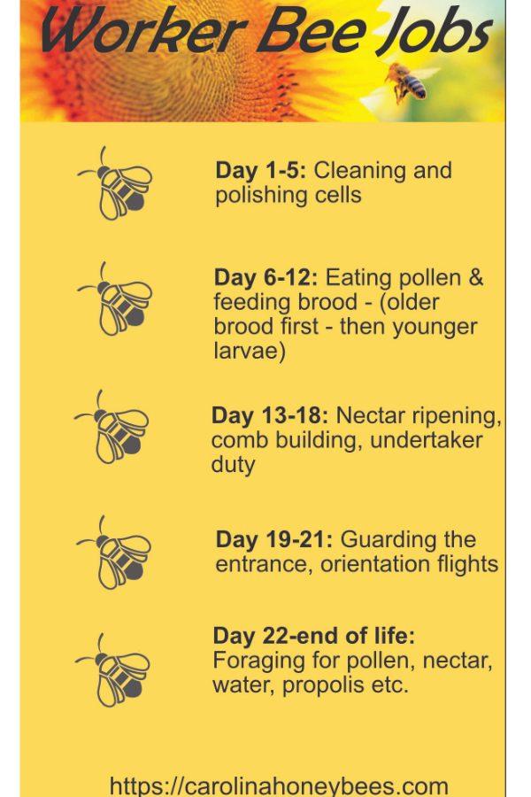

Slide 14
Lessons from worker
½ of life in hive ½ as forager
Life tasks (feeding, receiving, waxmaking) are age regulated but bees can imperfectly adjust
Math works against requeening/swarming success (rule of 21)
SOLUTION?

Slide 15
How many eggs can queen lay?
Necessities for successful queen?
Notes:
Successful queen production:
Sufficient
Amount of cleaned cells/wax
Number of nurse bees
Number of receiver bees
Number of foragers

Slide 16
What can beekeeper do to help queen succeed?
Cells/Wax
Nurse bees
Receiver bees
Foragers
Notes:
Successful queen production:
Sufficient
Amount of cleaned cells/wax
Number of nurse bees
Number of receiver bees
Number of foragers

